Slide 1
From Source Code to Packages for Various Distributions
Andreas Jaeger
Program Manager openSUSE
aj@novell.com

Slide 2
Software Packaging is solved – is it?
How to reach many users with working software packages?
How to build for different distributions?
  different locations for config files, libraries etc.
How to build for different versions of a distribution?
How to build for different architectures?
How to build in such a way that local modifications of build machine will not effect the built package?
Notes:
Note: RPM, Deb are considered the solved part – question is how to create them

Slide 3

OBS is the Rescue
build binary packages for many distributions and platforms
make them available for download
make them available in your own OBS repository

Slide 4
Build Service Demo

Slide 5
Demo Script (this slide is not shown!)
See screencast at http://www.youtube.com/watch?v=irPIM-gCKRwI
Info: http://lizards.opensuse.org/?p=5320

Slide 6
Background

Slide 7
Packages and Projects
All packages are part of a project
Multiple developers can work on a project and/or a package
Projects define the target distributions
Packages can be build for all or only a subset of defined target distributions

Slide 8
Automatic Dependency Rewriting
Problem: packages get renamed or are named different for different distributions.
  Example: package containing shared libraries for canna
  SUSE: canna-libs
  Fedora: Canna-libs
  Mandriva: libcanna1
  Debian: libcanna1g
Project can specify per repository dependency rewrite rules:
Substitute: <package> <replacement packages>

Slide 9
Adding Specials to Spec Files
Used statements:
%if 0%{?suse_version} < 1010
do something
%endif
%if 0%{?mandriva_version}
Name: libopensync
%else
Name: opensync
%endif

Slide 10
Automatic Rebuilding
Automatic rebuild (configurable) of package if dependent packages change
  avoids ABI incompatibilities
  avoids dependency on library that has been removed
  catches some changes in behavior of scripts/apps during build

Slide 11
OBS via command line - osc
osc add – add file to package
osc build – build on local machine
osc results – show build results from server
osc co – checkout package
osc ci – checkin package
osc branch – branch package for own development
osc submitrequest – request package checkin in another project
osc request – show and modify requests
Notes:
Don't explain everything, just say that you can do everything this way

Slide 12
OBS is...
Open Source under GPLv2
Developed by engineers from Novell, Cray, Intel, Nokia, … and individuals
Used by Cray, Dell, Intel, Nokia, LinuxFoundation, MeeGo,...
Used to create LiveCDs to demo products
Integrated in SUSE Studio and allows easy appliance creation with custom packages
Not working without packaging skills ;-)

Slide 13
Your Own OBS?
At http://build.opensuse.org you can build Open Source packages online for Debian, Fedora, Mandriva, openSUSE, Red Hat Enterprise Linux, SUSE Linux Enterprise,...
Alternative: install your own instance of OBS
  Available as source, ready-to-run appliance (virtual image) and installation media
  Support for additional architectures
  Quality of service, faster rebuild
  Instances can connect with each other - reference packages and repositories, e.g. the full openSUSE 11.3 distribution on build.o.o

Slide 14
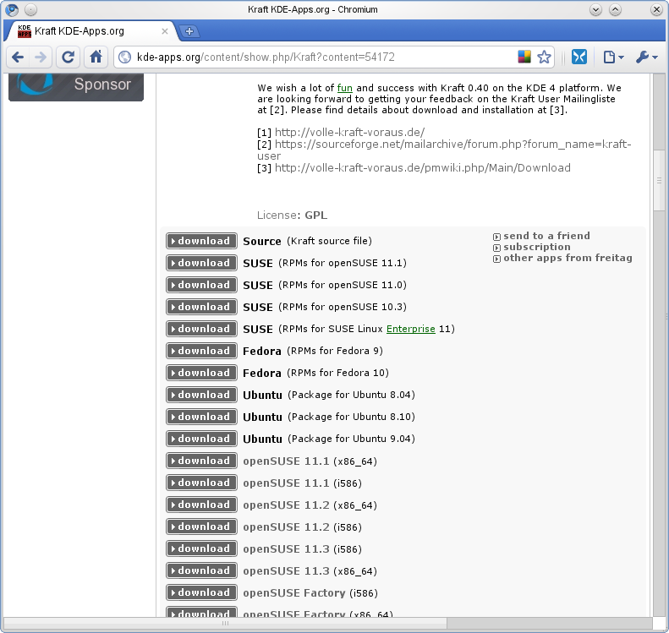
Integration with Forges
(planned - needs work by forges) Integration with Forges like SourceForge, Berlios, KDE-Apps
  Build package from the forge
  show on forge project page list of binaries
Notes:
Screenshot is from kde-apps
Build service delivers xml file that needs to be parsed and displayed
Xml file makes it easy to download packages

Slide 15
Unique Features of OBS
Building for multiple distributions
Automatic rebuilding on dependency change
Open System – nice integration with IDEs, Forges and tools
Easy to install

Slide 16
New in OBS 2.1
Source services, checkout from svn/git
Enhanced WebUI:
  Source handing
  Revision control
  Source services editing
  Create submit requests
  Source history

Slide 17
Try it!
http://build.opensuse.org to build packages for Debian, Fedora, Mandriva, openSUSE, Red Hat Enterprise Linux, SUSE Linux Enterprise,...
Source code: git@gitorious.org:opensuse/build.git
Documentation incl. local installation instructions: http://wiki.opensuse.org/Portal:Build_Service
Communication:
  opensuse-buildservice@opensuse.org
  #opensuse-buildservice, IRC freenode

Slide 19
Unpublished Work of Novell, Inc. All Rights Reserved.
This work is an unpublished work and contains confidential, proprietary, and trade secret information of Novell, Inc. Access to this work is restricted to Novell employees who have a need to know to perform tasks within the scope of their assignments. No part of this work may be practiced, performed, copied, distributed, revised, modified, translated, abridged, condensed, expanded, collected, or adapted without the prior written consent of Novell, Inc. Any use or exploitation of this work without authorization could subject the perpetrator to criminal and civil liability.
General Disclaimer
This document is not to be construed as a promise by any participating company to develop, deliver, or market a product. It is not a commitment to deliver any material, code, or functionality, and should not be relied upon in making purchasing decisions. Novell, Inc. makes no representations or warranties with respect to the contents
of this document, and specifically disclaims any express or implied warranties of merchantability or fitness for any particular purpose. The development, release, and timing of features or functionality described for Novell products remains at the sole discretion of Novell. Further, Novell, Inc. reserves the right to revise this document and to make changes to its content, at any time, without obligation to notify any person or entity of such revisions or changes. All Novell marks referenced in this presentation are trademarks or registered trademarks of Novell, Inc. in the United States and other countries. All third-party trademarks are the property of their respective owners.

